Slide 1
What’s Cooking
Eka Renardi

Slide 2
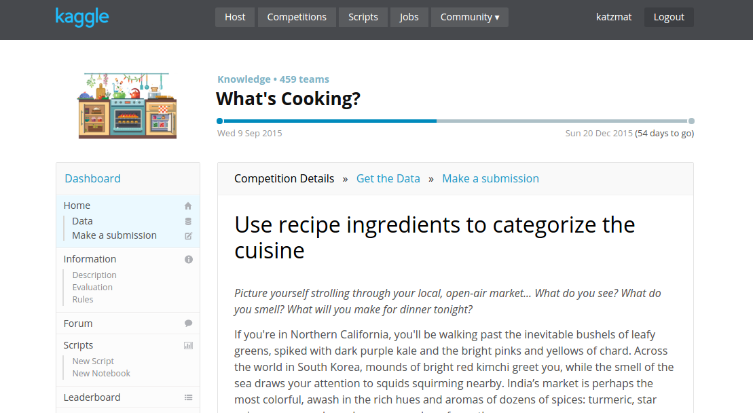
Kaggle Competition

Slide 3
Problem
Classify ‘cuisine’ based on ‘ingredients’

Slide 4
Data
Provided by Yummly
Text data
39,000+ observations
3 Columns:
id: numeric, unique identifier
cuisine: text, 20 classes
ingredients: list of text

Slide 5
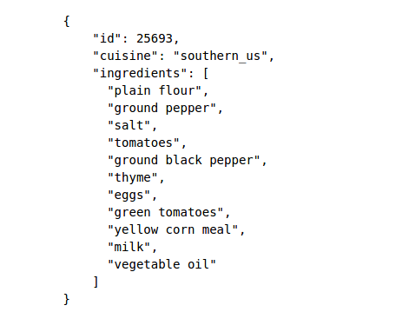
Sample Data

Slide 6
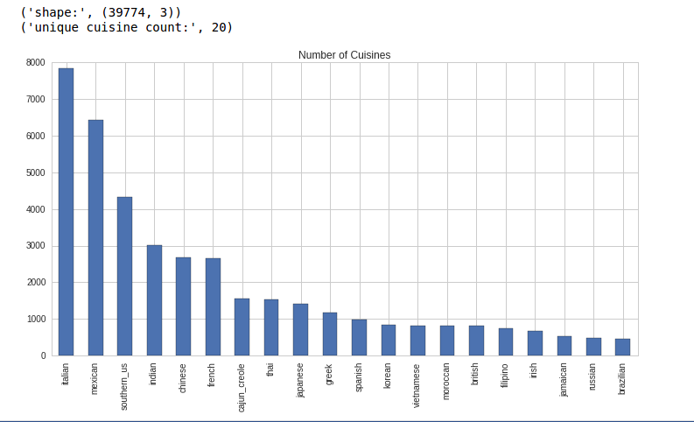
Cuisine
brazilian
british
cajun_creole
chinese
filipino
french
greek
indian
irish
italian
jamaican
japanese
korean
mexican
moroccan
russian
southern_us
spanish
thai
vietnamese

Slide 7
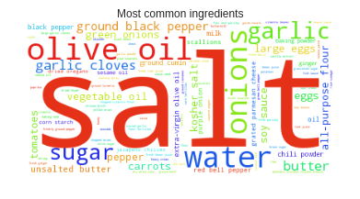
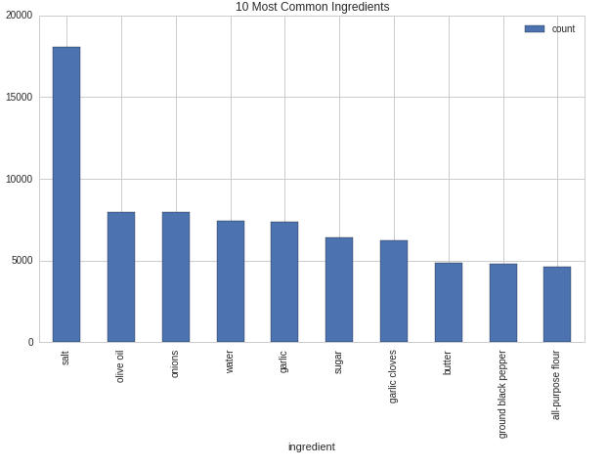
Ingredients
What’s the most common ingredients

Slide 8
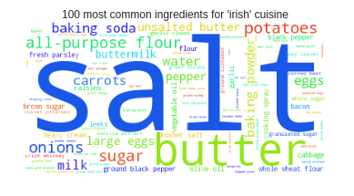
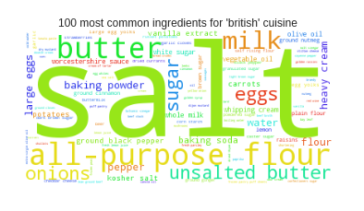
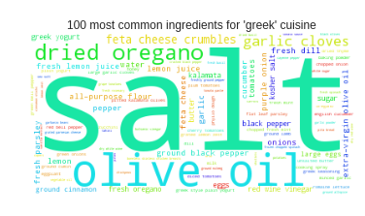
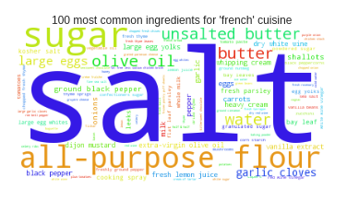
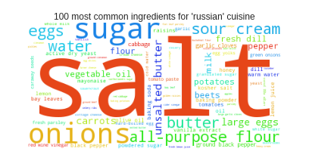
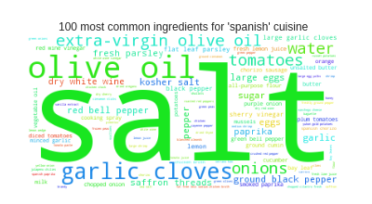
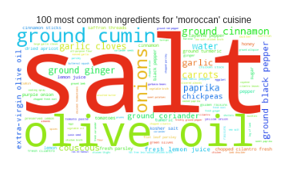
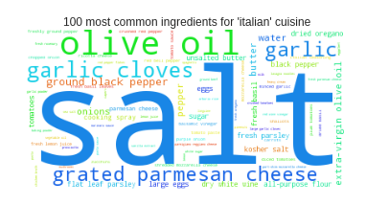
Ingredients (Europe)

Slide 9
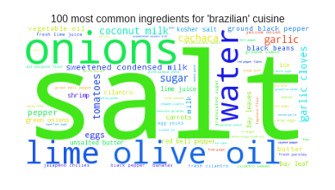
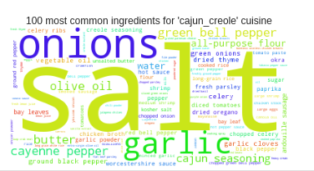
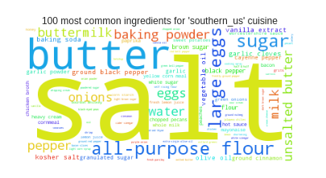
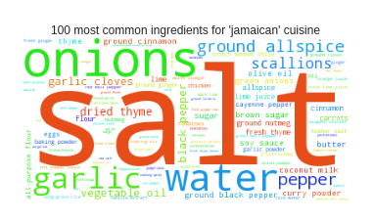
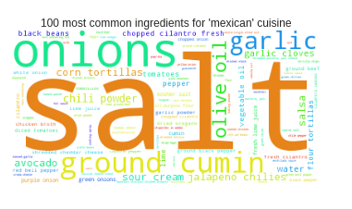
Ingredients (Americas)

Slide 10
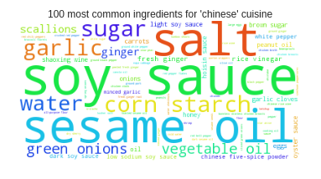
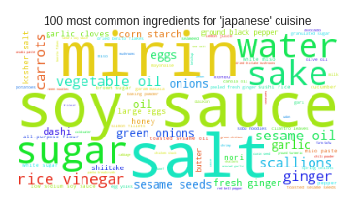
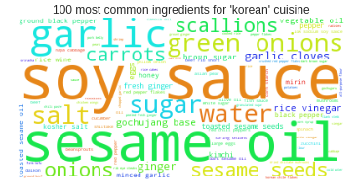
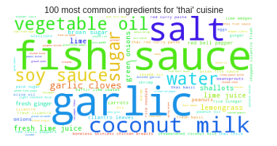
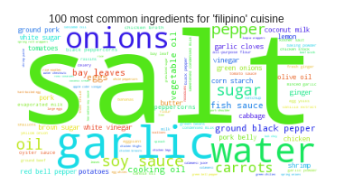
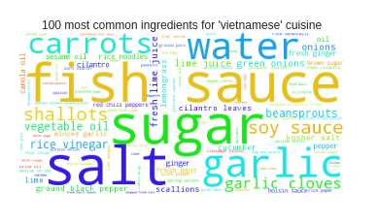
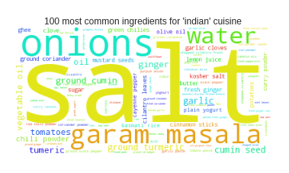
Ingredients (Asia)

Slide 11
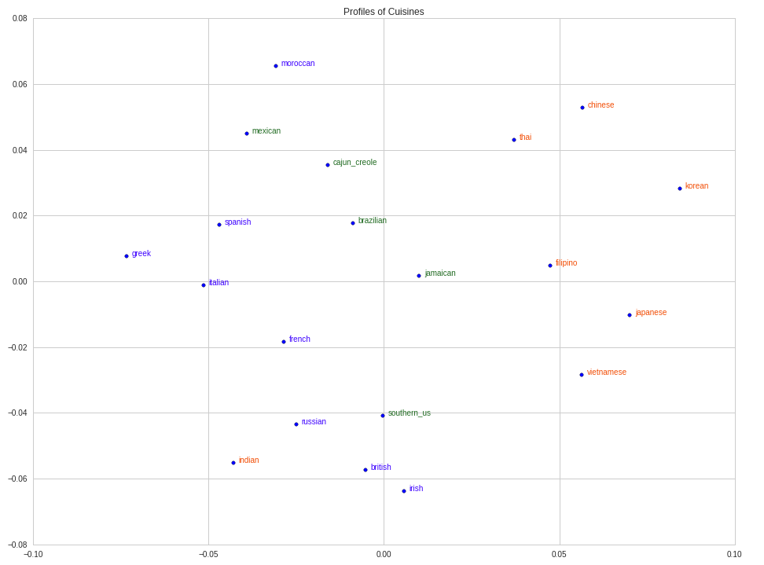
Ingredients <-> Cuisine Relationship

Slide 12
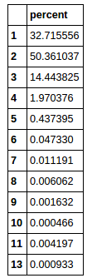
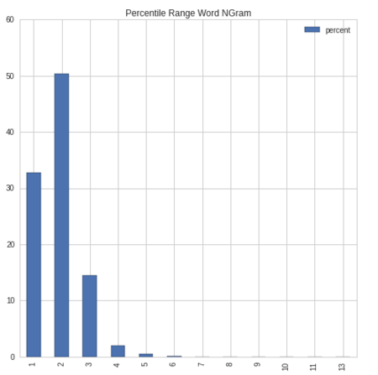
Ingredients (Word Ngram)
# words in an ingredient (e.g. Salt = 1 word, Black Pepper = 2 words)

Slide 13
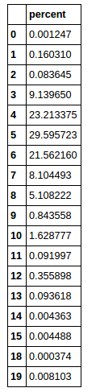
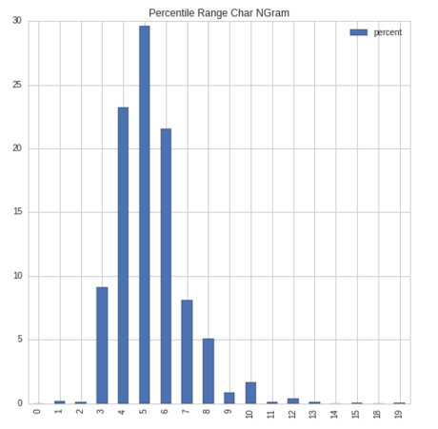
Ingredients (Char NGram)
# characters per word (e.g. Salt = 4 chars)

Slide 14
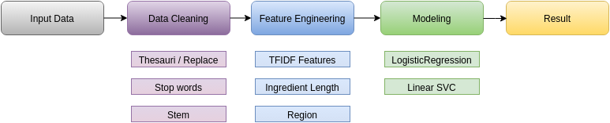
Model Building

Slide 15
Data Cleaning
Word replacement (e.g. Philadelphia Cream Cheese -> cream cheese)
Read from a text file (thesauri.txt)
Stop words (e.g. and, &)
Read from a text file (stopwords.txt)
Stemming (e.g. apples -> apple)

Slide 16
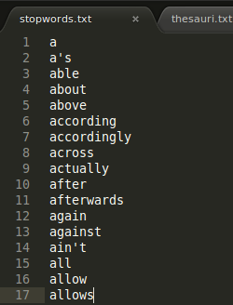
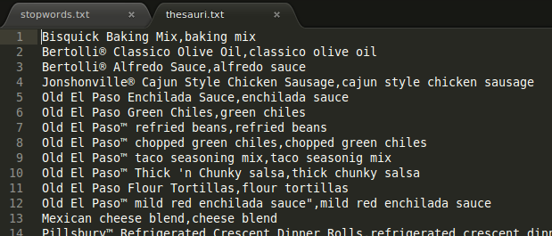
Data Cleaning Files

Slide 17
Feature Engineering
TFIDF features: ngram, max_features
Ingredient length
Region encoding (work in progres…)

Slide 18
Modeling
Logistic Regression. Classic classification algorithm.
Linear SVC. Large dimensions.

Slide 19
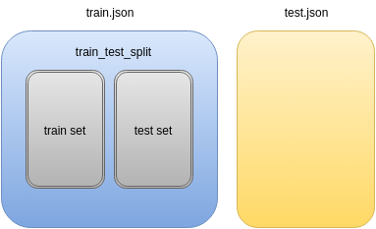
Model Building
Use cross validation, and GridSearchCV with 5 folds.
Uses ‘Pipeline’ heavily
Scoring on ‘Accuracy’
Test on entire train.json
Default train test split

Slide 20
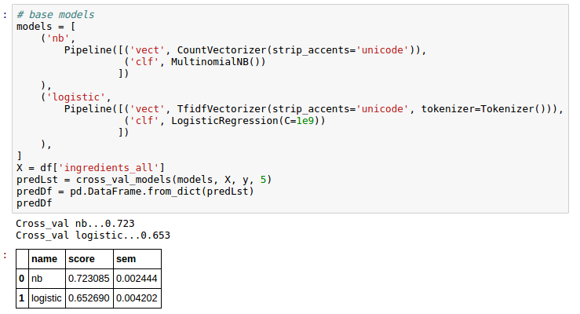
First Model

Slide 21
Data Cleaning Effect on Models
With no data cleaning, accuracy is 0.734
With data cleaning, accuracy is 0.743

Slide 22
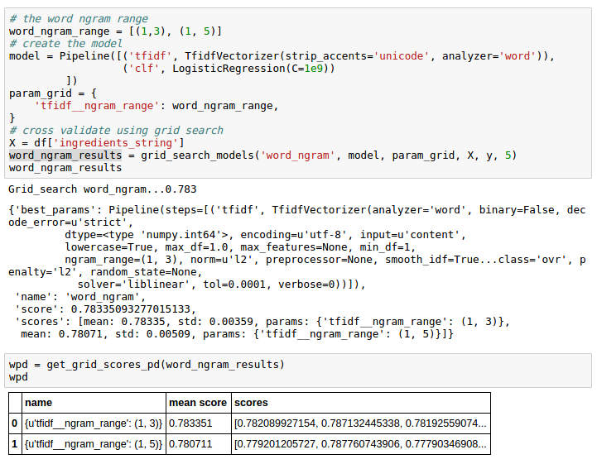
TFIDF Tuning (Word Ngram)

Slide 23
TFIDF Tuning
char ngram: accuracy 0.772, no improvement
max_features: accuracy: 0.471, no improvement.

Slide 24
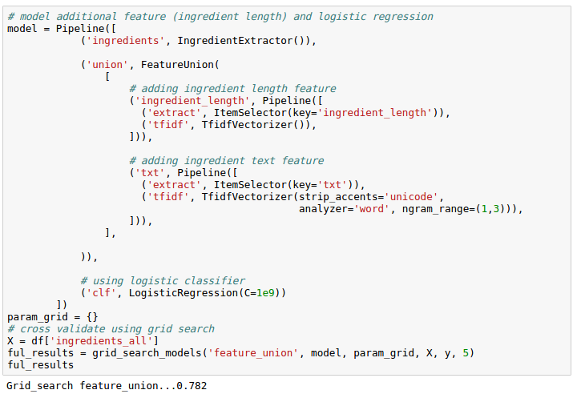
Adding Ingredient Length
No improvement

Slide 25
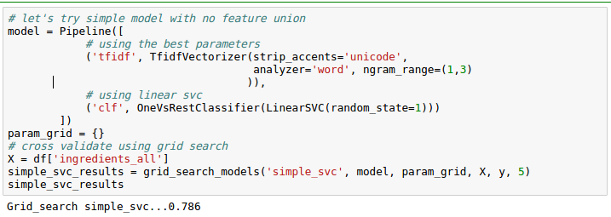
Linear SVC (base)
Best model so far, with accuracy of 0.786

Slide 26
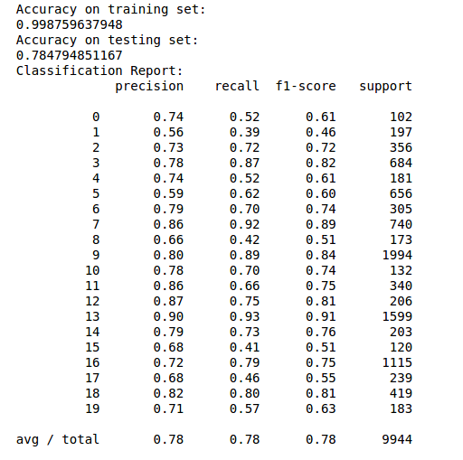
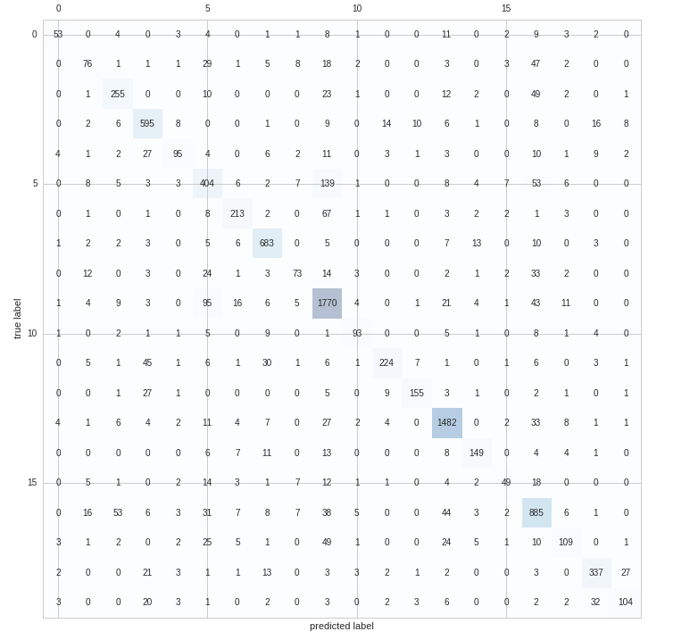
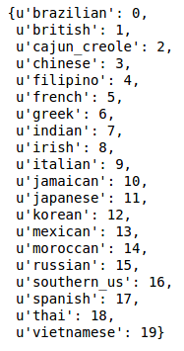
Prediction Result

Slide 27
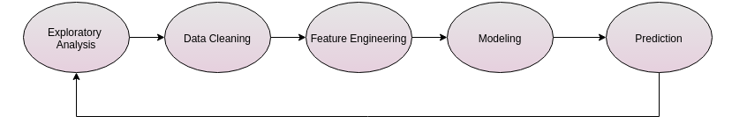
Conclusion
Iterative approach to problem solving
Feature engineering is time consuming, but may improve the score.
Attempt different algorithms.

Slide 28
What’s Next
More feature engineering
Ensembling

